Slide 1

The Contemporary Art Video Game
By Nabil Mir

Slide 2
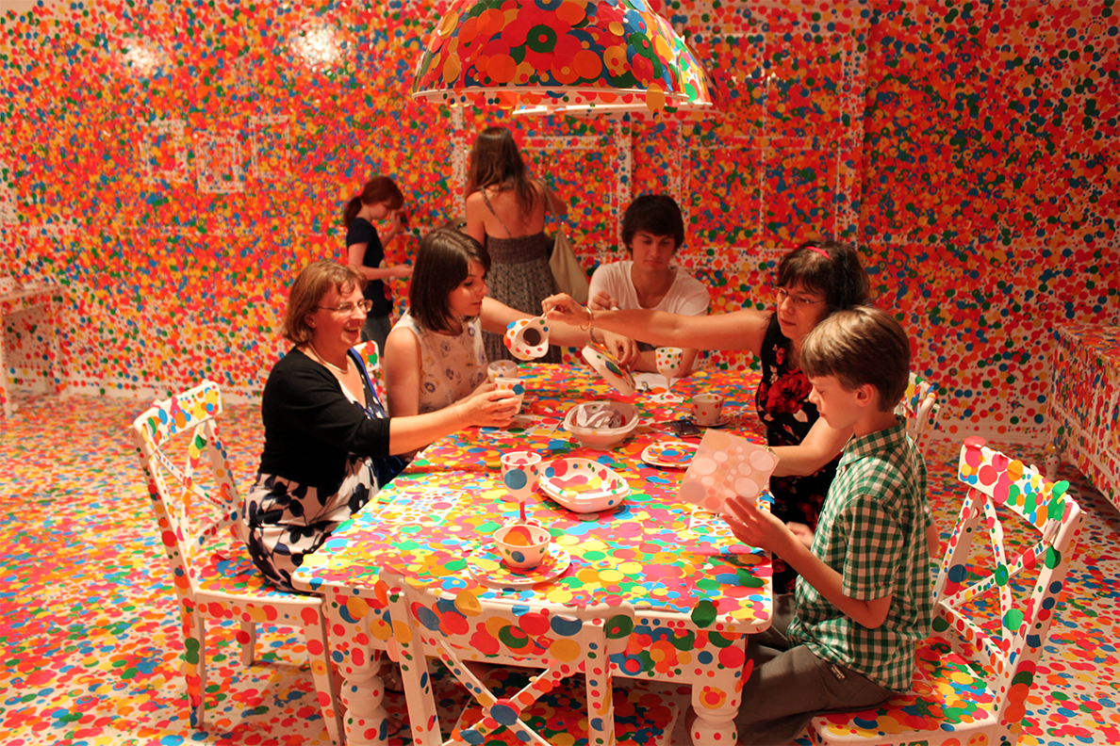
The Obliteration Room, Yayoi Kusama
Elementary school children are my target audience, but all ages are welcome.

Slide 3
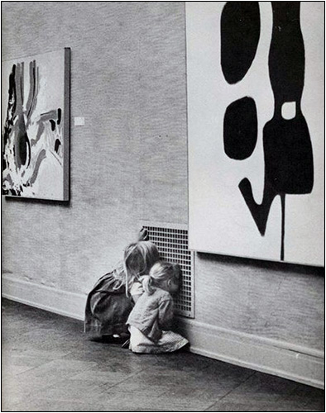
Many kids are not very familiar with contemporary art…

Slide 4
The 'culture starved' generation emerged in a study of 2,000 parents of 5 to 12 year-olds throughout the UK.
4 in 10 children have never seen the inside of an art gallery, while 17% haven't visited a museum with their parents.
The research, which was commissioned by Visit Birmingham, also revealed that a quarter of children haven't been to the theatre, while 6 in 10 have never heard or been to a classical music concert.
1 in 10 kids hasn't even left their home town to visit other cultural sites in the UK.
http://www.telegraph.co.uk/culture/culturenews/9071698/Four-in-10-children-have-never-been-to-an-art-gallery.htm
February 2012

Slide 5
Scary Scarabee , Kim De Molenaer
How do we make contemporary art more accessible?

Slide 6

Darth Vader Tries to Clean the Black Sea With Brita Filter,
Daniel Bozhkov
Art teaches valuable, lifelong skills.
Studio Thinking: The Real Benefits of Visual Arts Education by Lois Hetland, Ellen Winner, Shirley Veenema, and Kimberly M. Sheridan

Slide 7
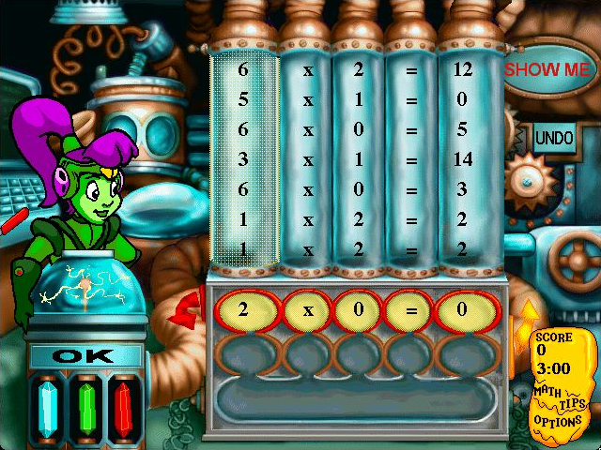
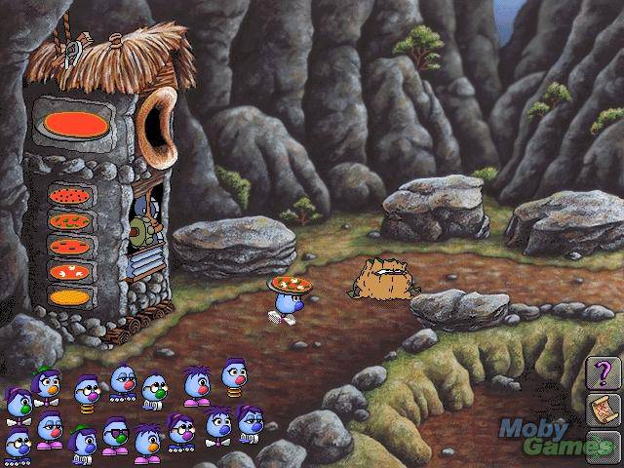
The Logical Journey of the Zoombinis, 1996
Mega Math Blaster, 1997
There is a dearth of video games that focus on art education as well…

Slide 8



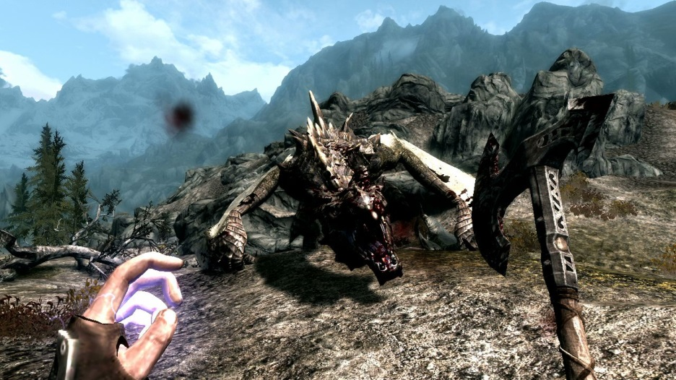
↑Minecraft, ↓Super Smash Bros Series
↑Five Nights at Freddy’s, ↓The Elder Scrolls V: Skyrim
These are some video games popular with children.

Slide 9


The Contemporary Art Video Game

Slide 10


Slide 11

Grounded Vindaloop, South Park
Will use the Oculus Rift for a virtual gallery hopping experience.

Slide 12
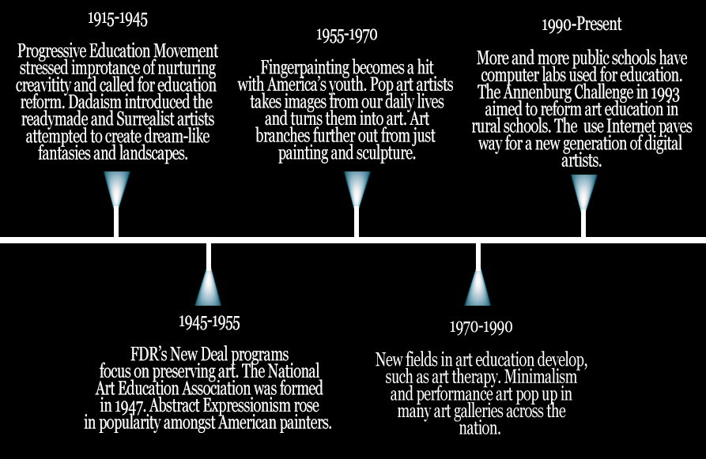
Timeline

Slide 13
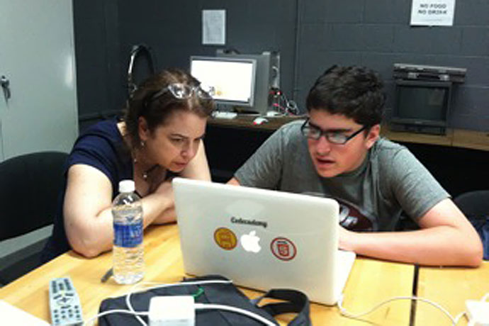
My thesis advisor is Beth Rosenberg.

Slide 14
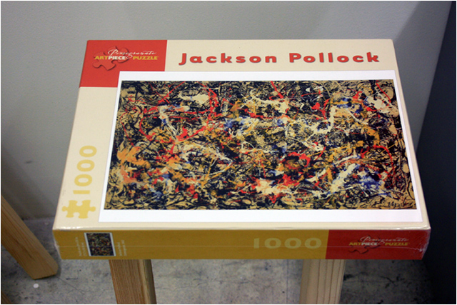
Onward...

Slide 15


